Slide 1






RXJS & NGRX
Reactive Extensions Library for JavaScript & Angular Reactive Extensions (Redux)
By : Mahmoud Abdelaziz and Omar Walid

Slide 2
Day 01

Slide 3
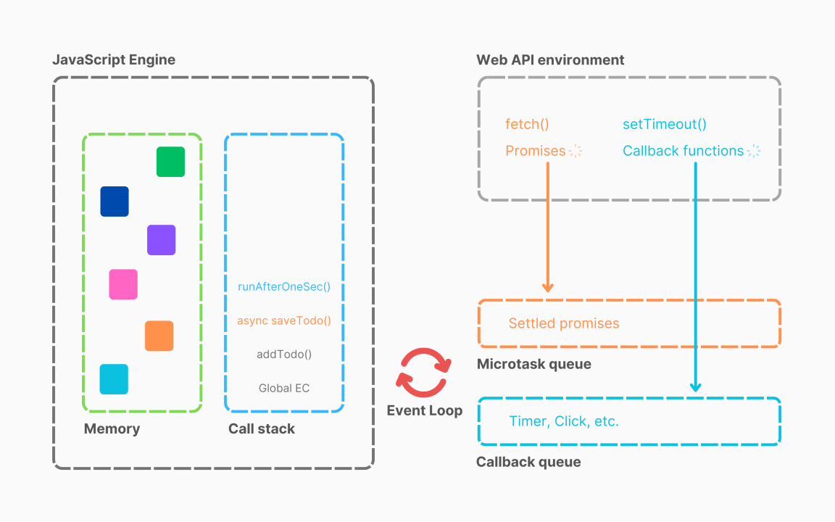
Synchronous vs Asynchronous
1

Slide 4
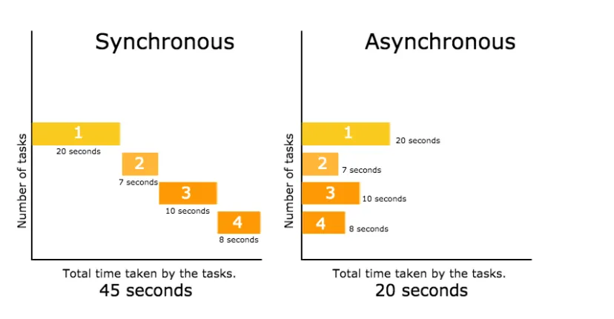
Synchronous vs Asynchronous
2

Slide 5
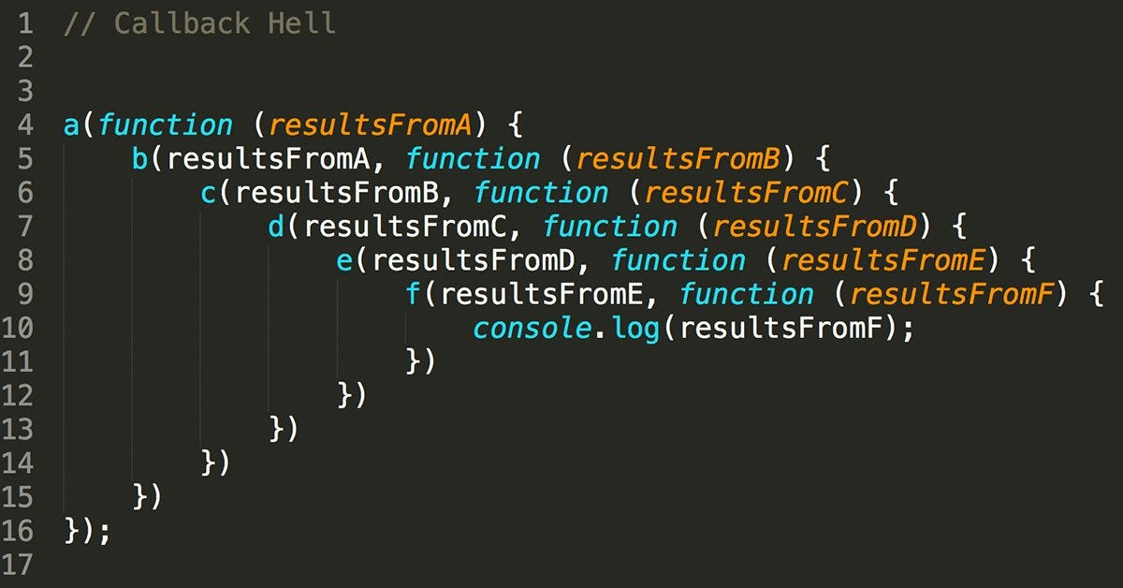

Introduction
Callback Hell:

Slide 6



Introduction
Coding
Callback
Promise

Slide 7
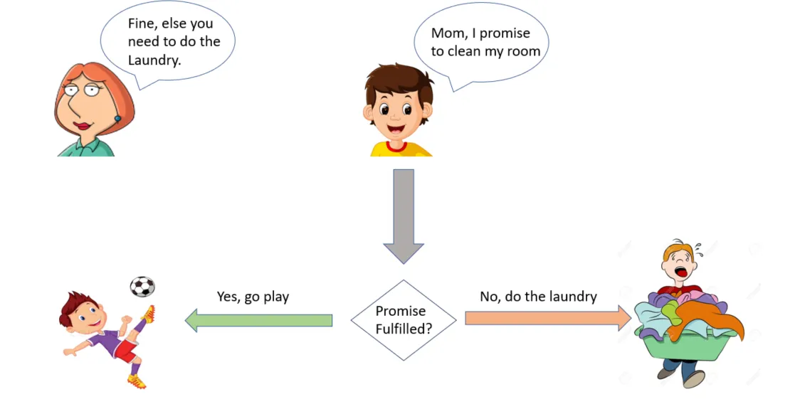

Introduction
Promises:

Slide 8
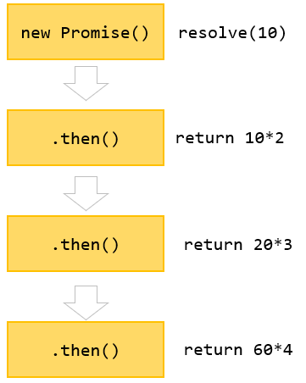
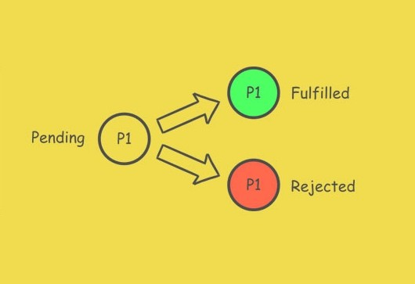

Introduction
Promises:

Slide 9



Introduction
Coding
Callback
Promise
RXJS

Slide 10


1
RXJS [Reactive Extensions Library for JavaScript ]
2
3
RXJS is a library for Composing Asynchronous and event-based programs by using Observable sequences.
4
?
?
?
Stream
vs
Reactive Stream
Pull vs Push Systems
Sync vs Async

Slide 11


Push vs Pull Systems
Pull |  | Push
Consumers pull (request) data from a producer. Consumer controls when data is requested. |  | Data is pushed to consumers asynchronously. Producer controls when data is sent.
Single | Multi | Single | Multi
Regular Fun | Fun Generator | Promise | Observable

Slide 12
Stream vs Reactive Stream
Stream | Reactive Stream
Collection Of Data [Size Predetermined] | Event [Size Unknown]
Iterable | Observable
Timers
Event-Based
Observable
10

Slide 13
Composing
A
B
C
X
g(x)
f(g(x))
f
g
g(f(x))
x
f(x)
gof
11

Slide 14
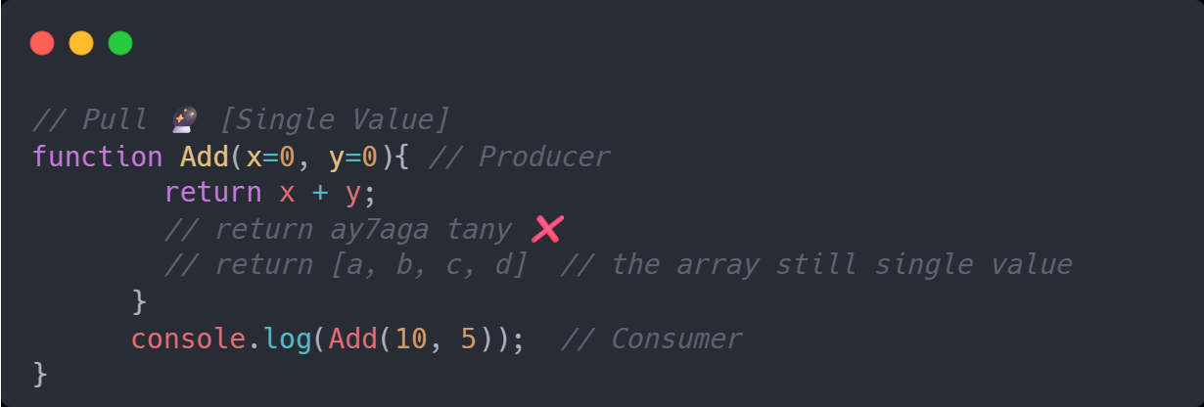
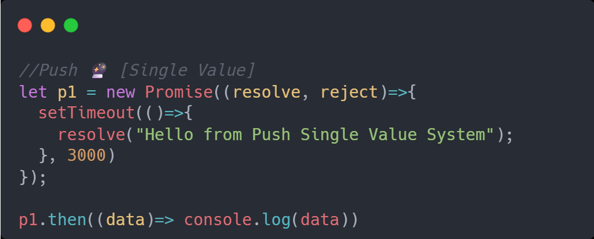
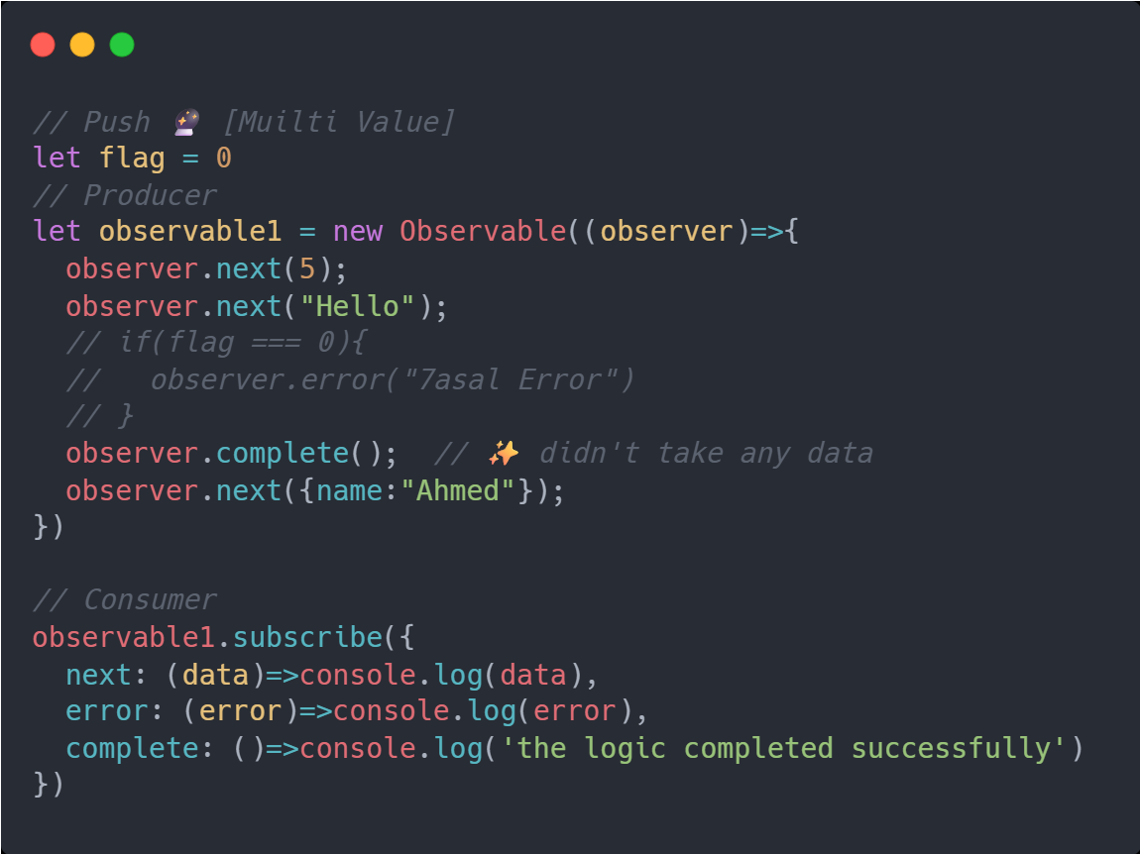
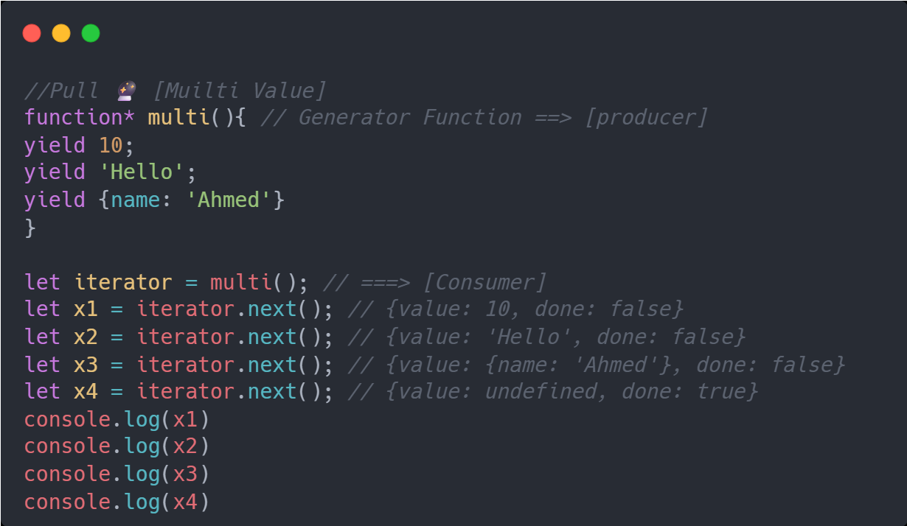
Pull vs Push Sys
Pull
[single Value]
Push
[single Value]
Pull
[Multi Value]
Push
[Multi Value]
12

Slide 15
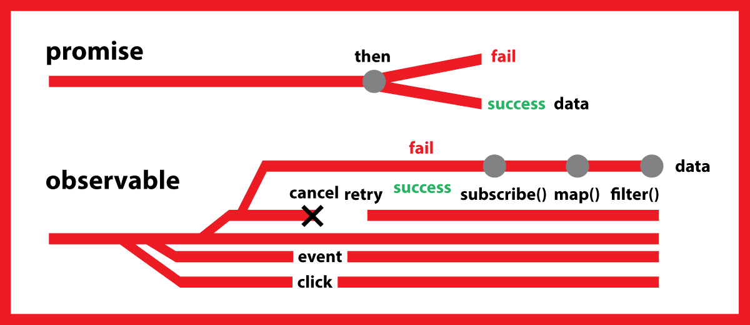
Observables vs Promises
Promises | Observables
Single Value | Multiple Value
Not Lazy | Lazy
Not Cancelable | Cancelable
Not Completion Callback | Completion Callback
13

Slide 16
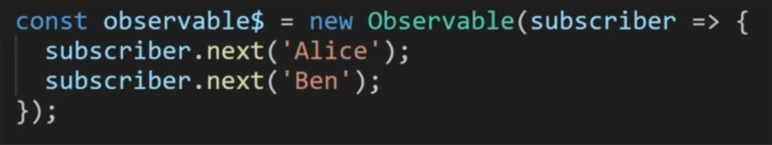
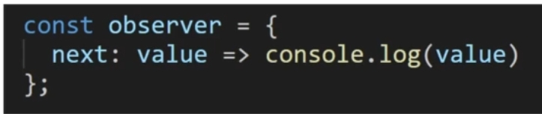

Observables vs Promises
Observable
Observer
Subscription
14

Slide 17
Observables
Subscribe1
Observable
Sub1
Still getting Data
from Observable
Subscribe2
if
Observable
Observable
Sub2.unsubscribe();
Means Sub2
Stop getting Data From Observable
Subscribe3
Observable
Sub3
Still getting Data
from Observable
15

Slide 18
Observables
Subscribe1
Observable
Sub1
Stop getting Data
from Observable
if
Subscribe2
observer. complete();
Means Observable
Itself will not send any data to
All Subscribers
Observable
Observable
Sub2
Stop getting Data
from Observable
Subscribe3
Observable
Sub3
Stop getting Data
from Observable
16

Slide 19
Observables
A
B
C
Compelete
A
B
C
Erorr
A
B
C
17

Slide 20
Observables
A
B
C
D
E
A
B
C
D
E
A
B
C
A
B
C
18

Slide 21
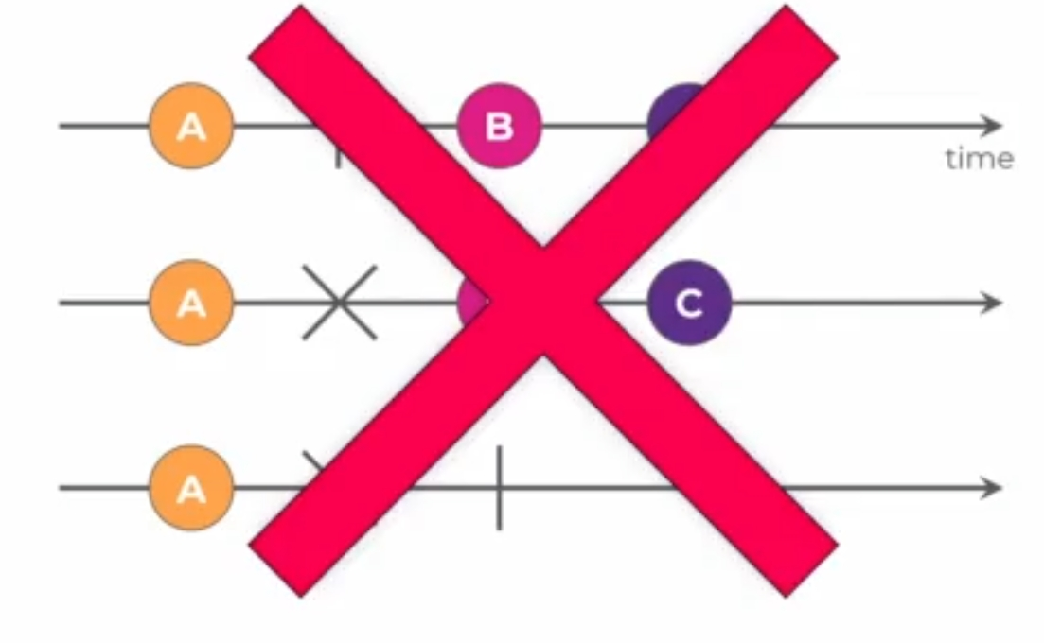
Observables
ALL ARE INVALID SENARIOS
19

Slide 22
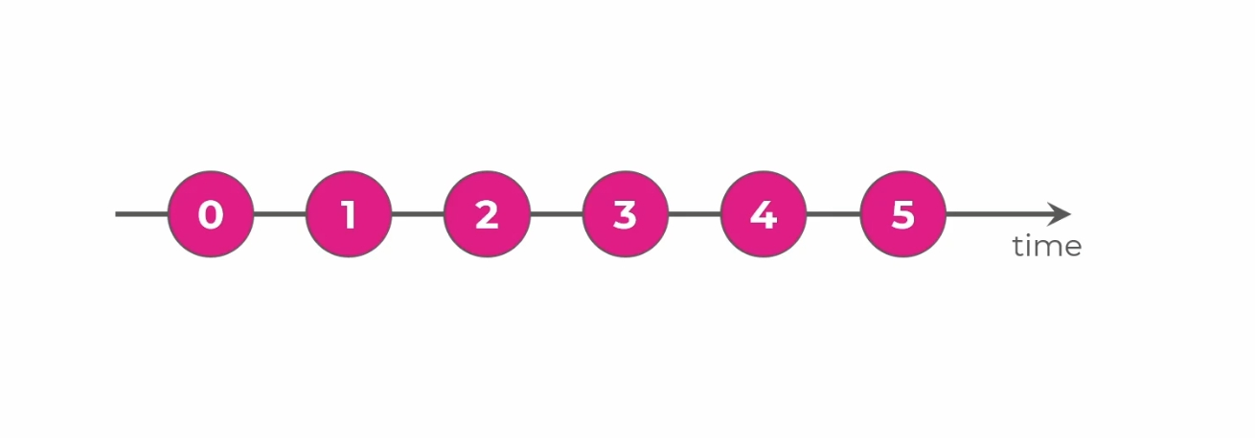
Observables
20

Slide 23
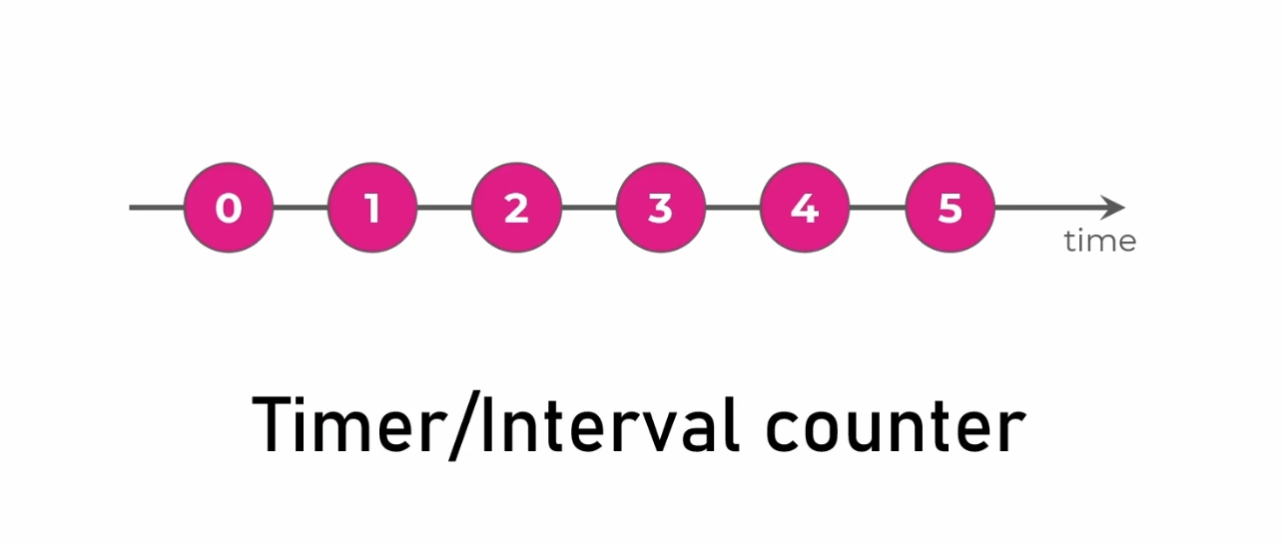
Observables
21

Slide 24
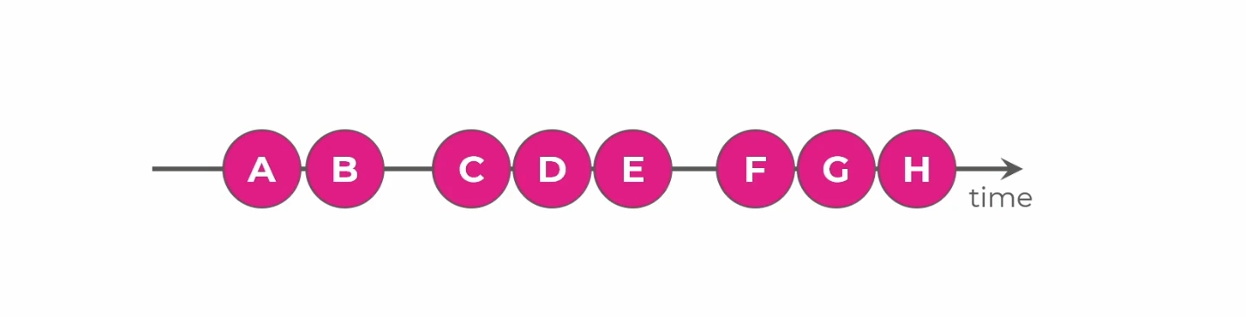
Observables
22

Slide 25
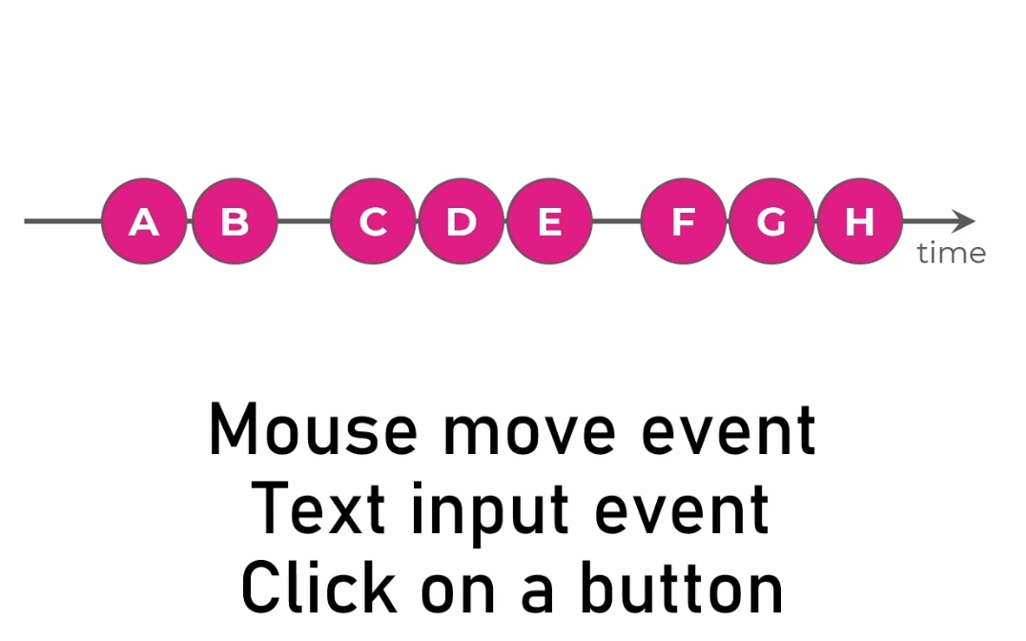
Observables
23

Slide 26
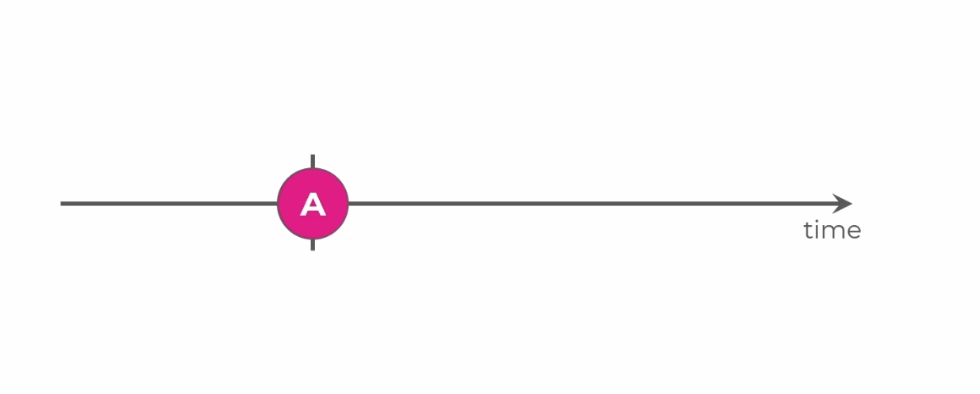
Observables
24

Slide 27
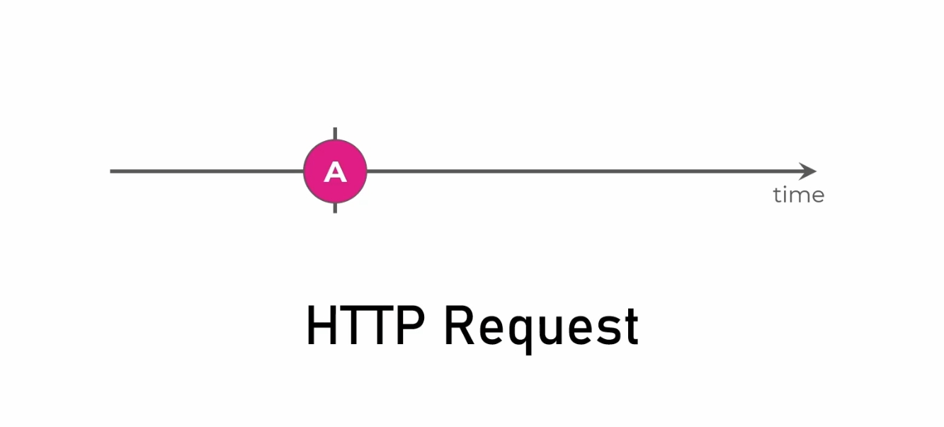
Observables
25

Slide 28
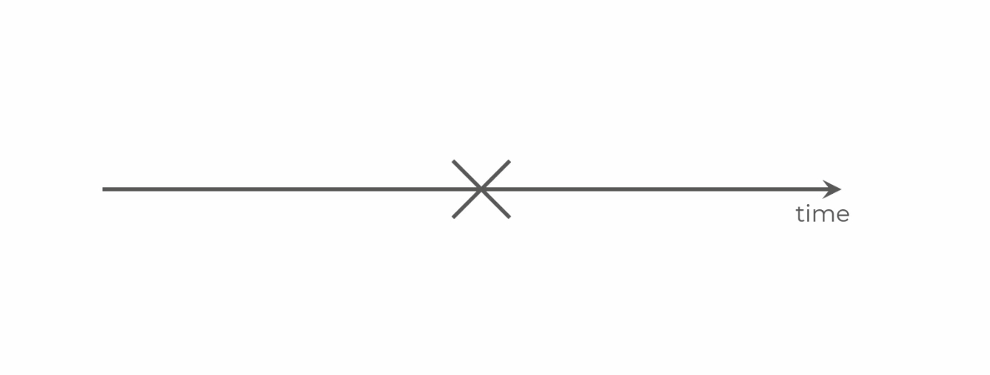
Observables
26

Slide 29
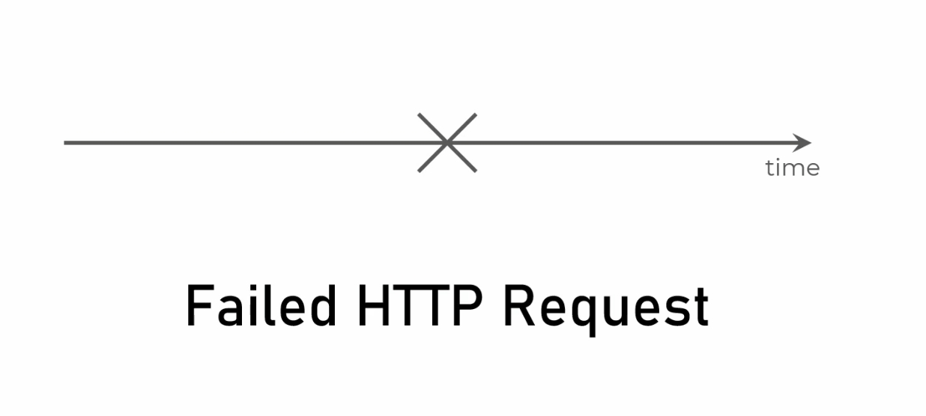
Observables
27

Slide 30
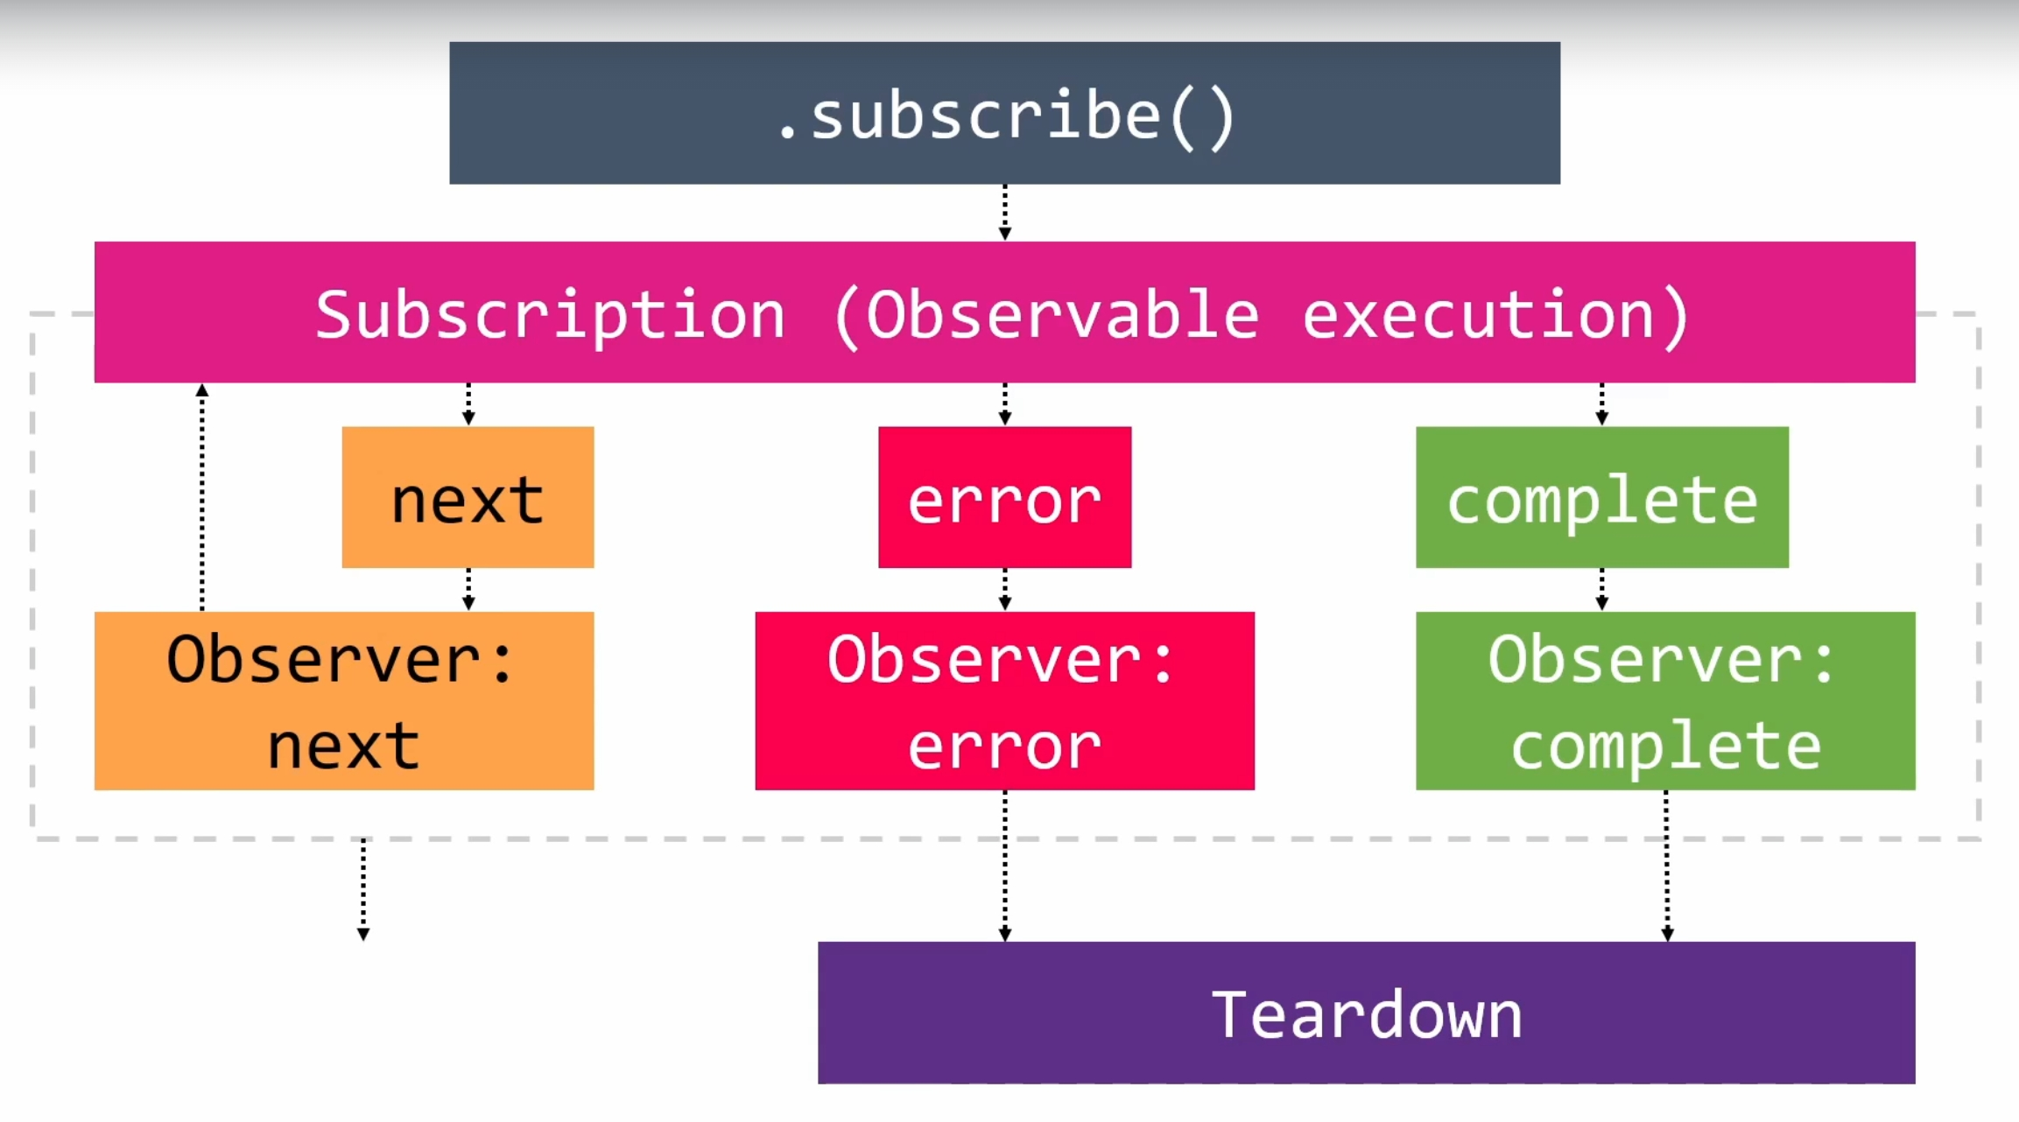
Observables
28

Slide 31
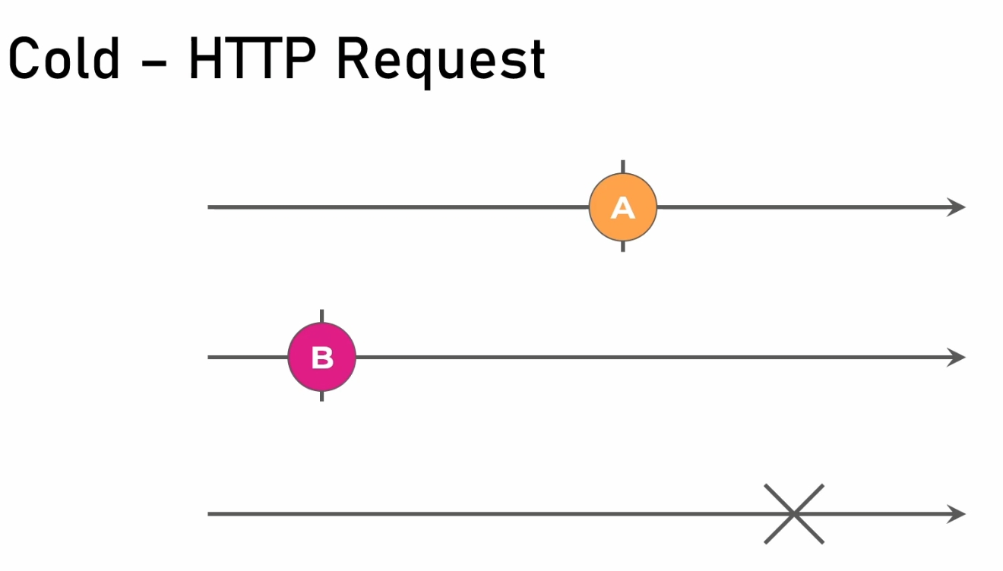
Creational Operators
18

Slide 32
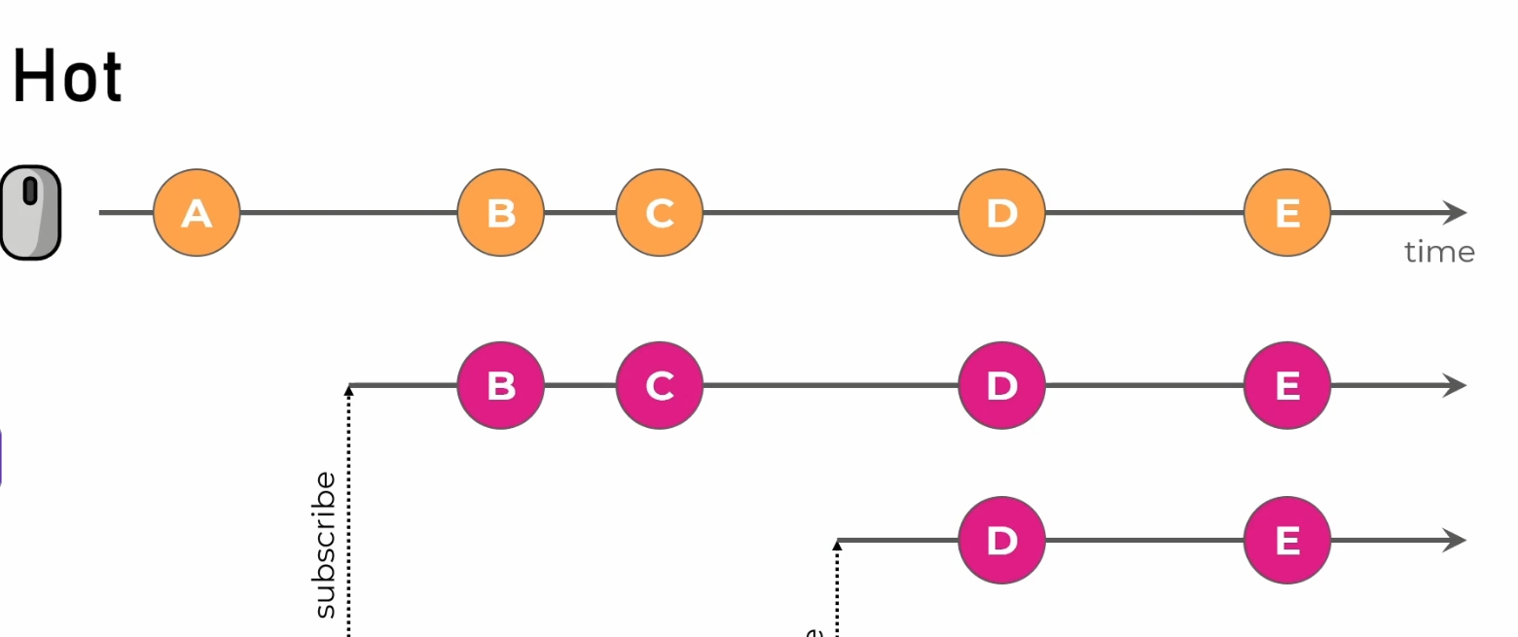
Creational Operators
18

Slide 33
Operators
Operators
Pipe
Creational Operators
Pipeable Operators
☝️
first and then
👇
EX 👉
Interval
Of
From
Timer
Range
Map
Filter
First
Take
TakeUntil
👈 EX
17

Slide 34
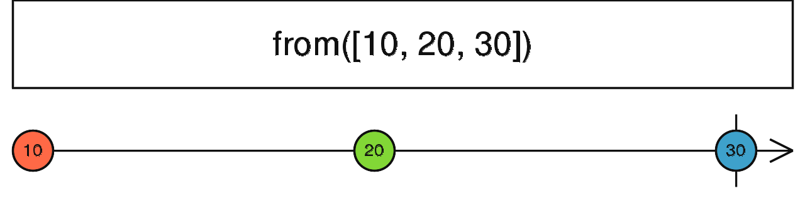
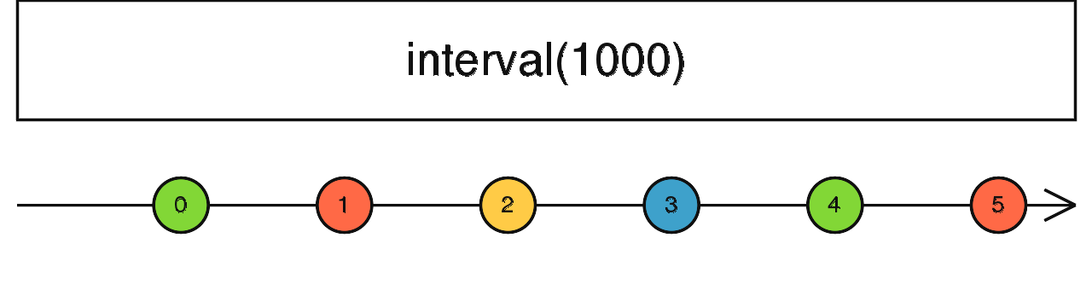
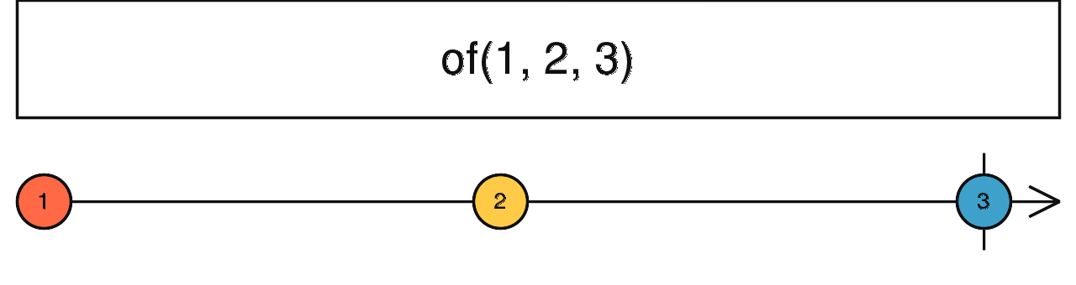
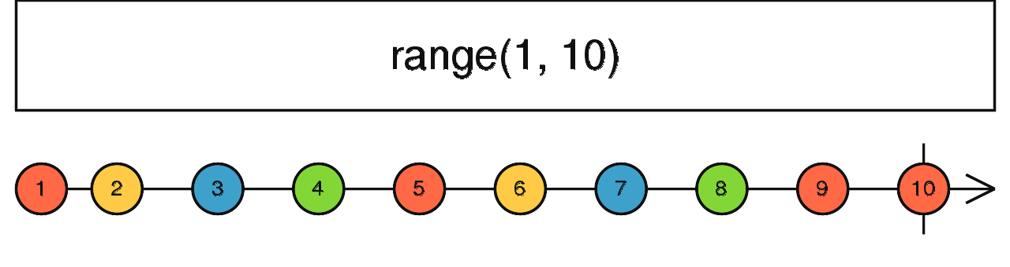
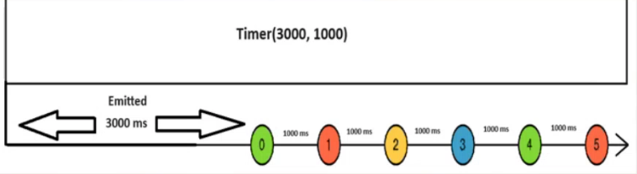
Creational Operators
18

Slide 35
Event Observable
JavaScript
RXJS
Return Observable
document.getElementsByTagName(“body”)[0]
.addEventListener(‘click’,
() => {“You Clicked Now”})
Import {fromEvent} from ‘rxjs’;
Let evt$ = fromEvent(document, ‘click’);
evt$.subscribe({
next: () => {“You Clicked Now”}
})
25

Slide 36
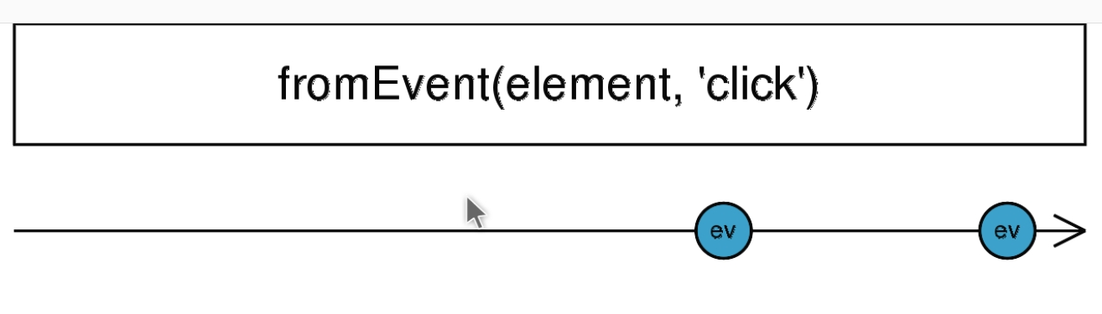
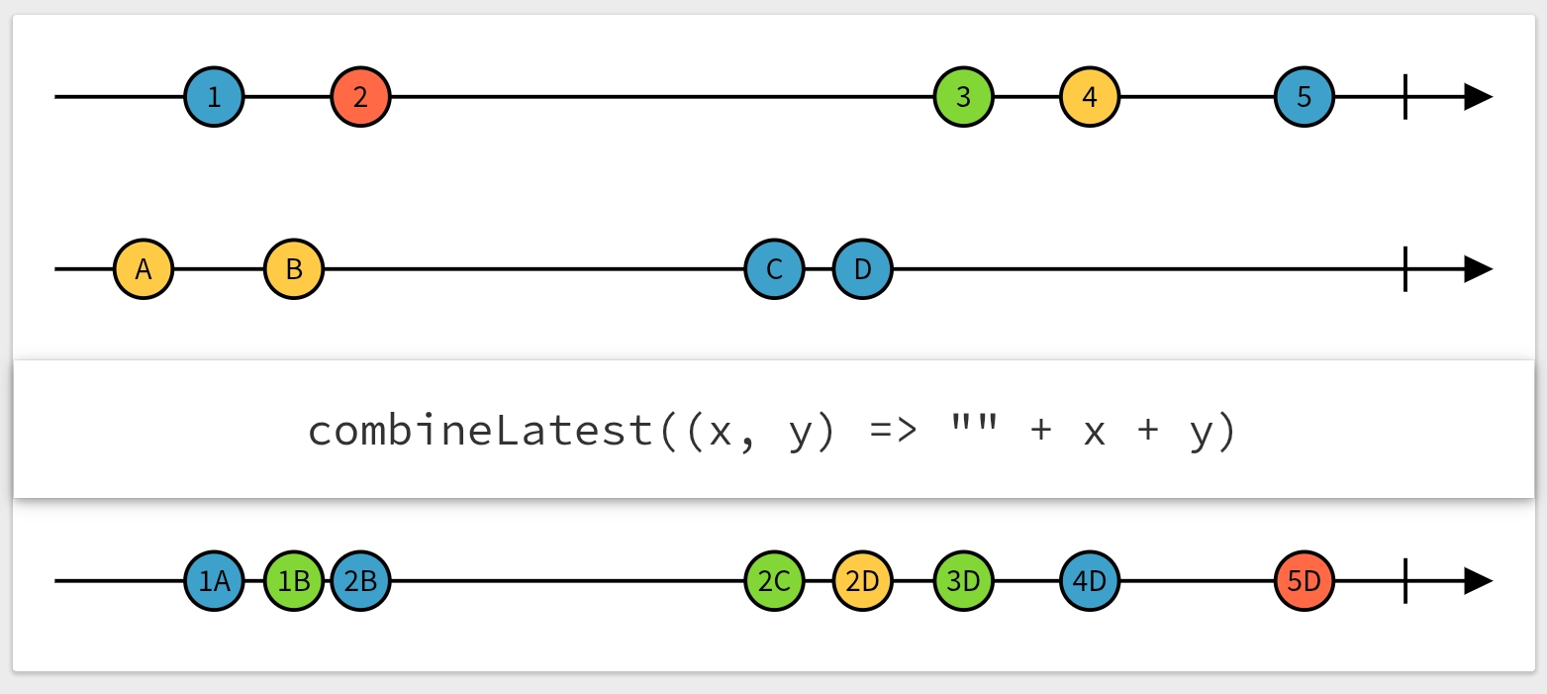
Creational Operators
18

Slide 37
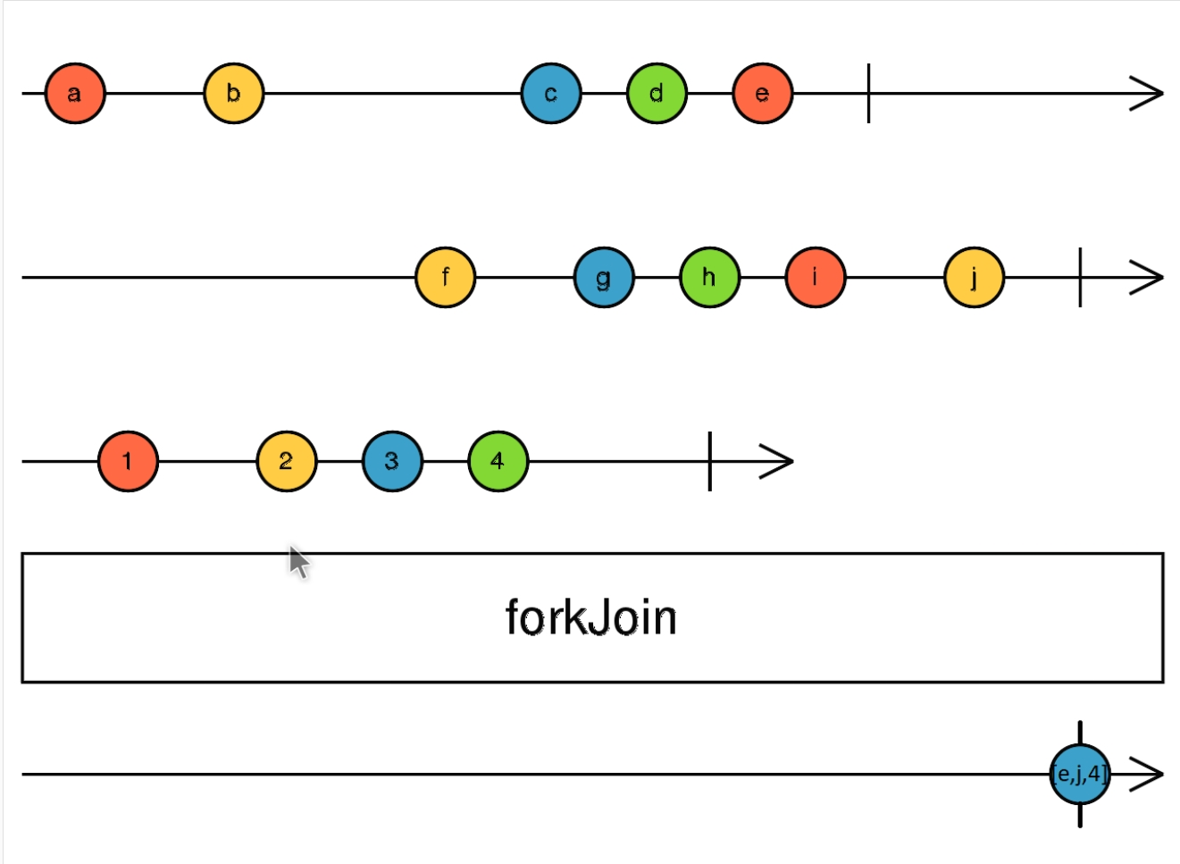
Creational Operators
18

Slide 38
Day 02

Slide 39
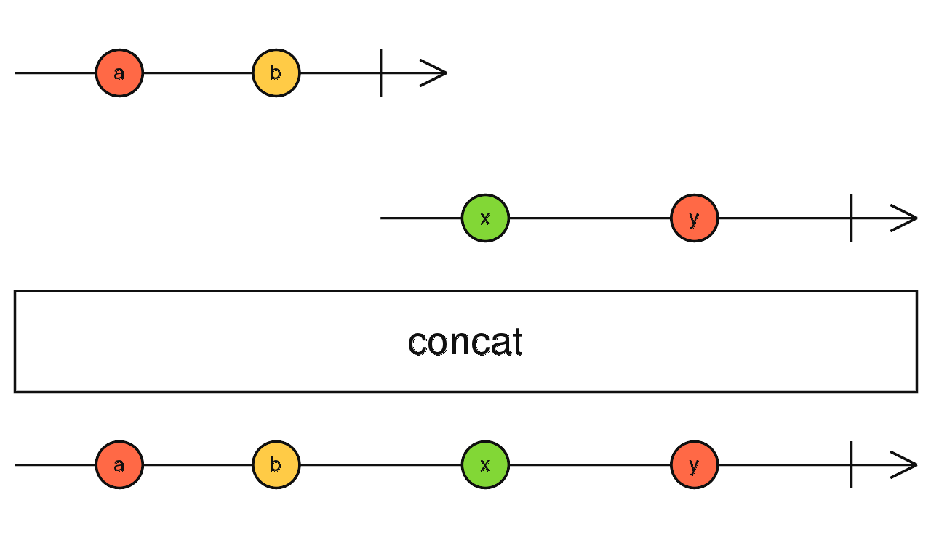
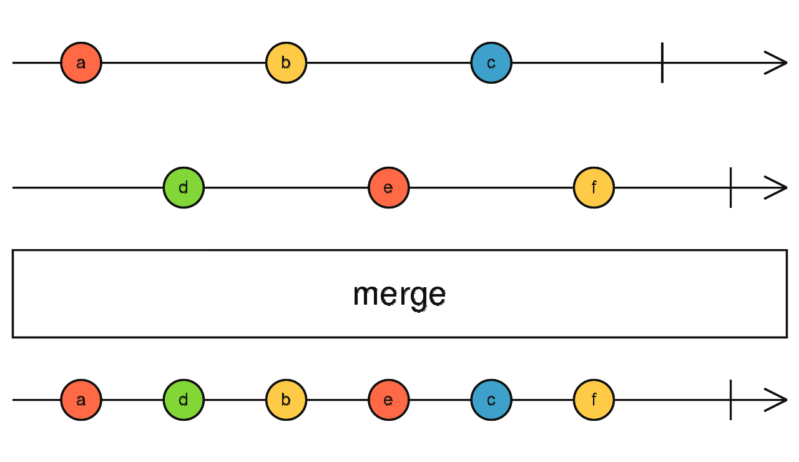
Creational Operators
19

Slide 40
Pipeable Operators
Consumer 1
Observable , of, timer, interval
Observable
Consumer 2
Consumer 3
20

Slide 41
Pipeable Operators
Pipe
Observable
(Transformed Data)
Observable (Data)
Consumer 1
Map (To Change Value)
Consumer 2
Consumer 3
21

Slide 42
Pipeable Operators
Pipe Composing
Observable
(Transformed Data)
Observable (Data)
Consumer 1
Map Filter
Consumer 2
Consumer 3
22

Slide 43
Pipeable Operators
Consumer 1
Observable
Consumer 2
Consumer 3
Pipe
Observable
(Transformed Data)
Observable (Data)
Consumer 1
Map (To Change Value)
Consumer 2
Consumer 3
Pipe Composing
Observable
(Transformed Data)
Observable (Data)
Consumer 1
Map Filter
Consumer 2
Consumer 3
23

Slide 44
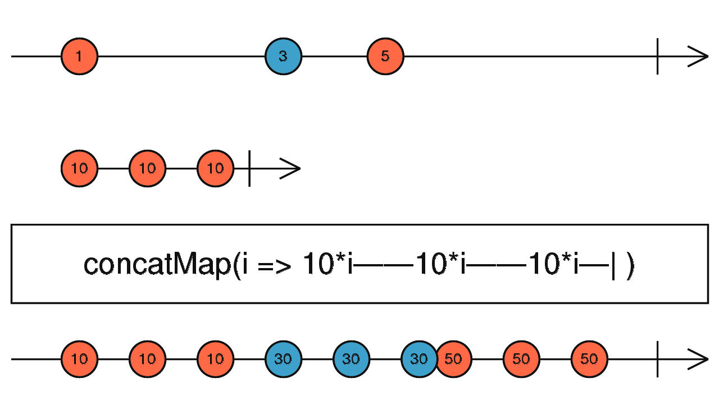
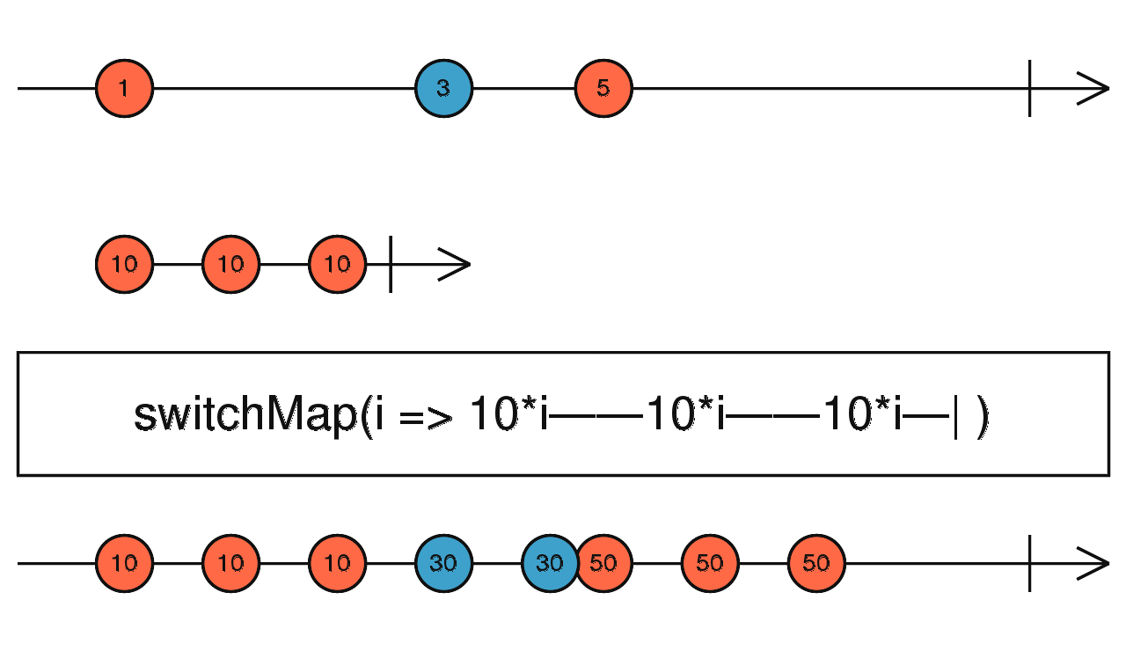
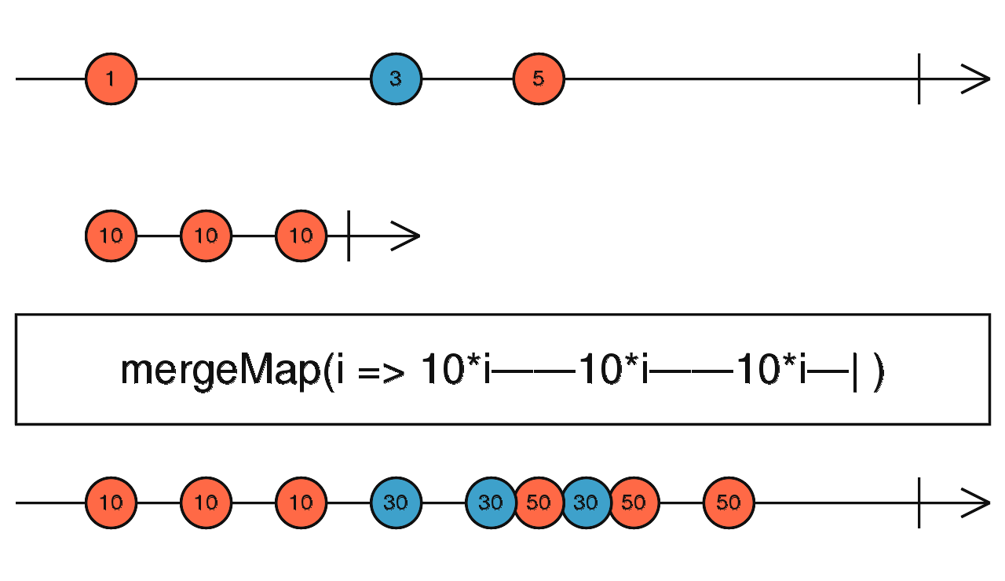
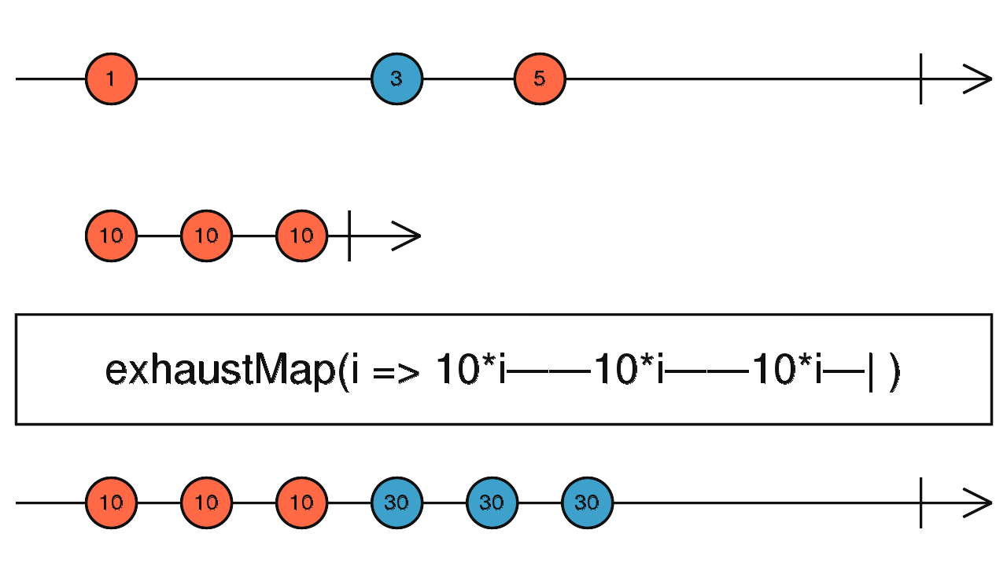
Higher Order Observables
24

Slide 45
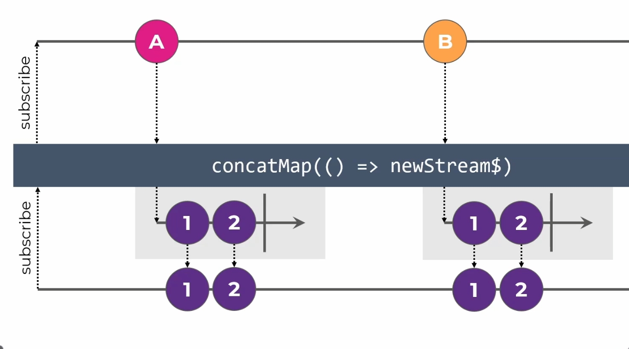
Higher Order Observables
24

Slide 46
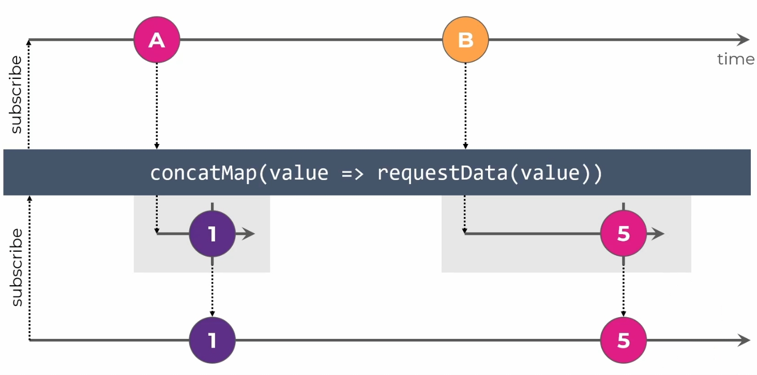
Higher Order Observables
24

Slide 47
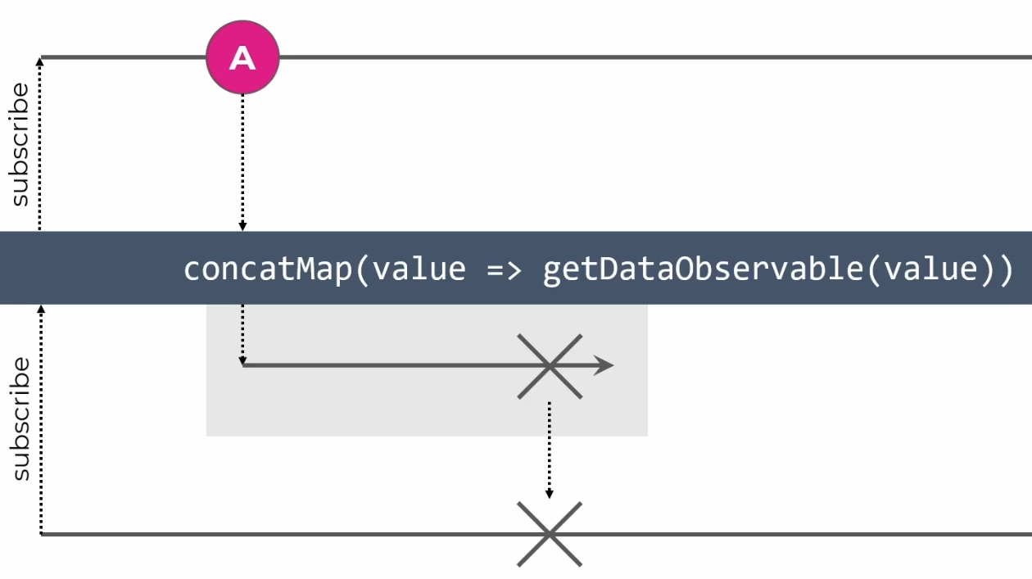
Higher Order Observables
24

Slide 48
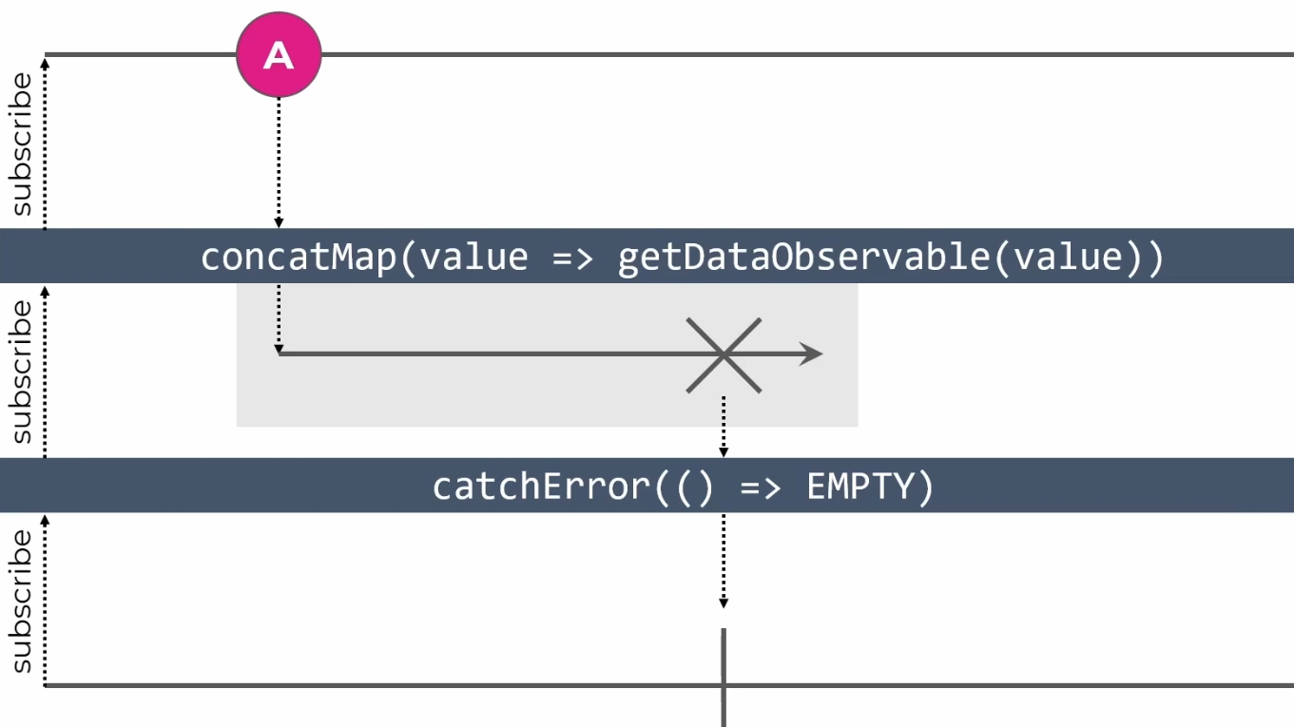
Higher Order Observables
24

Slide 49
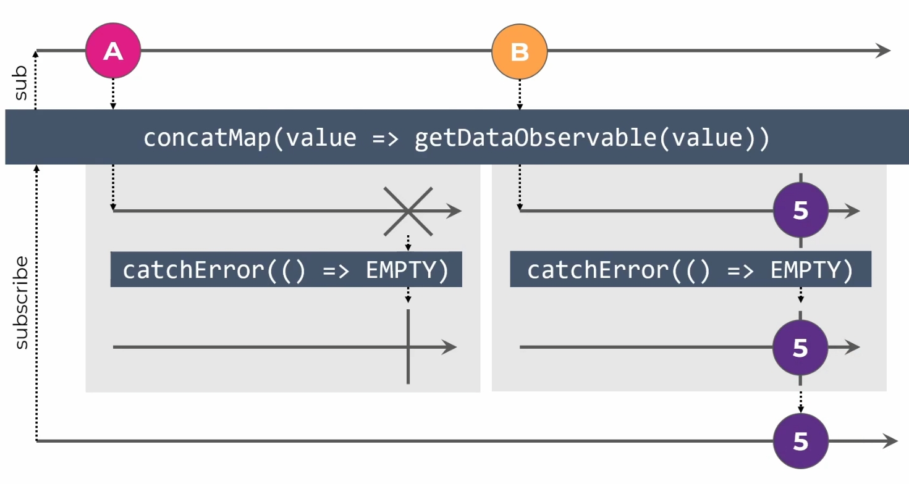
Higher Order Observables
24

Slide 50
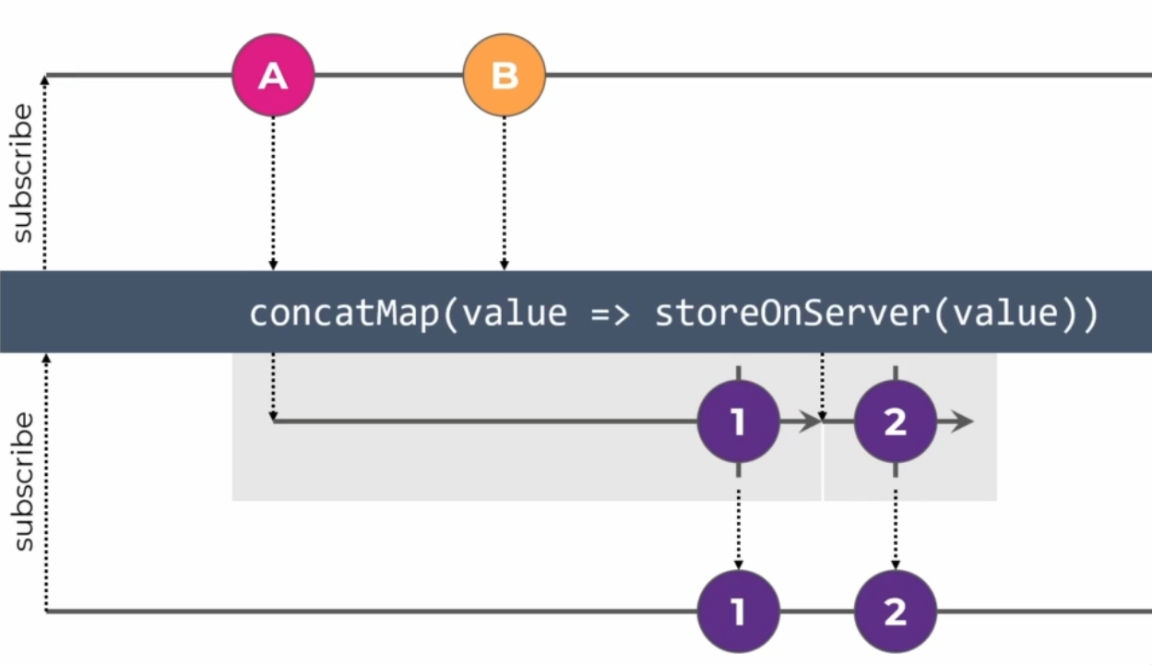
Higher Order Observables
24

Slide 51
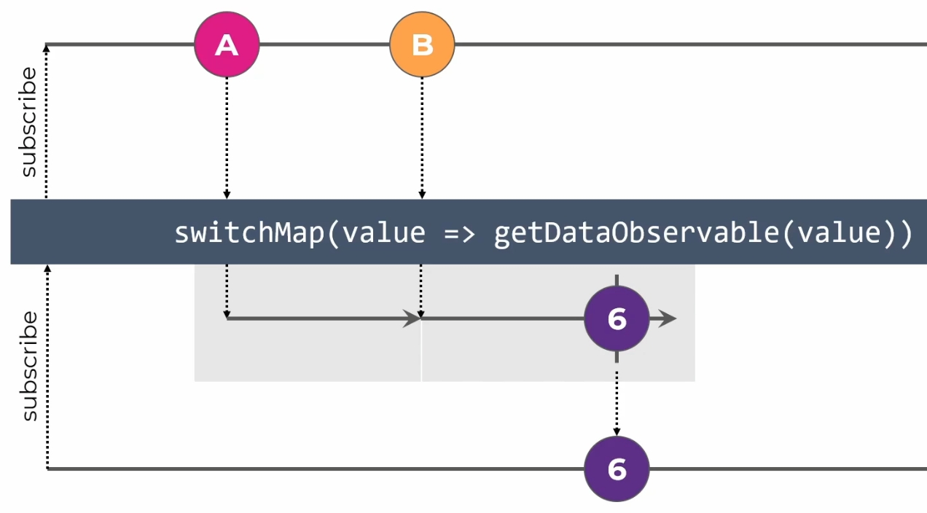
Higher Order Observables
24

Slide 52
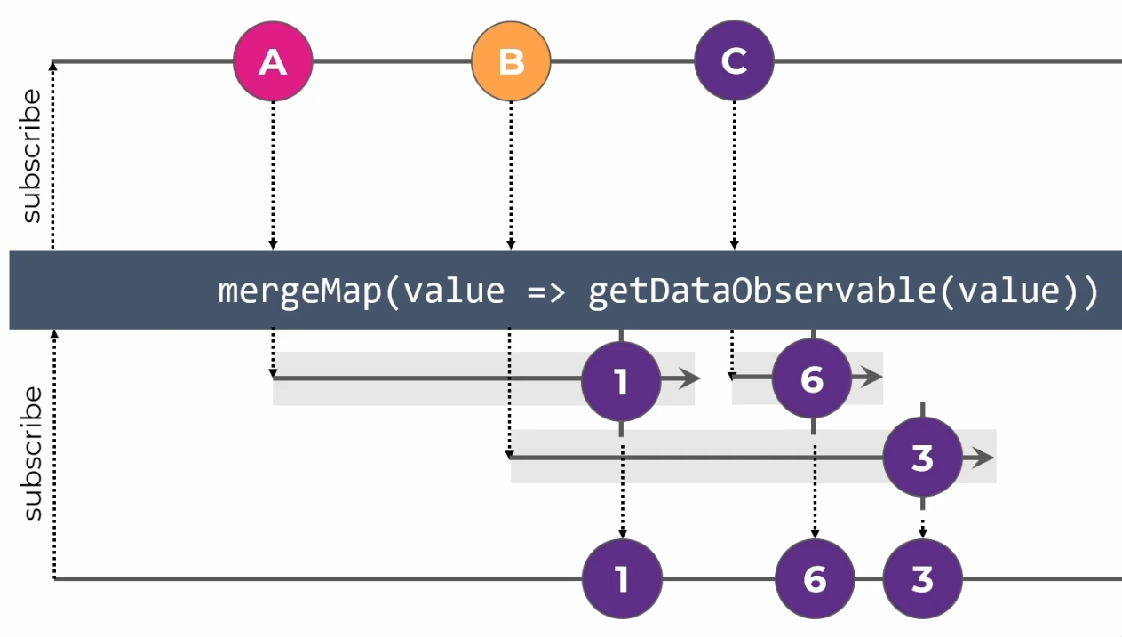
Higher Order Observables
24

Slide 53
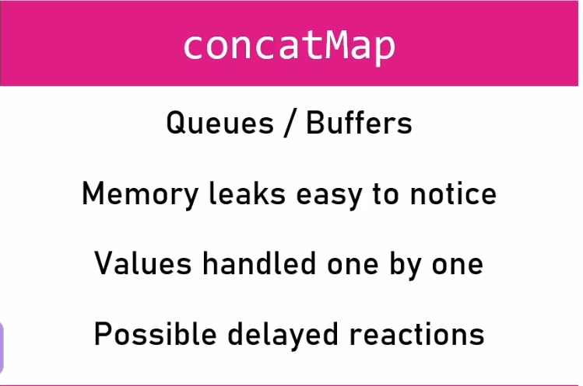
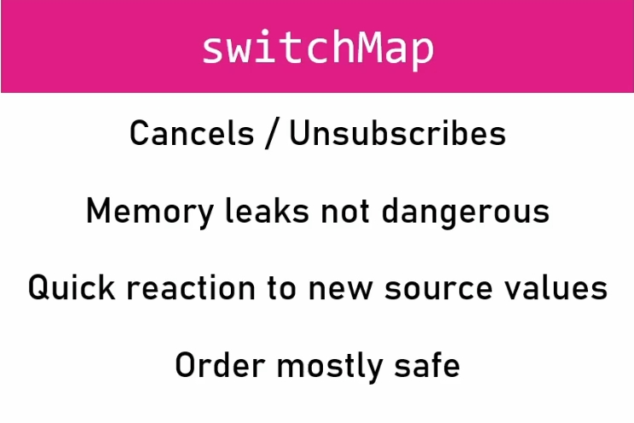
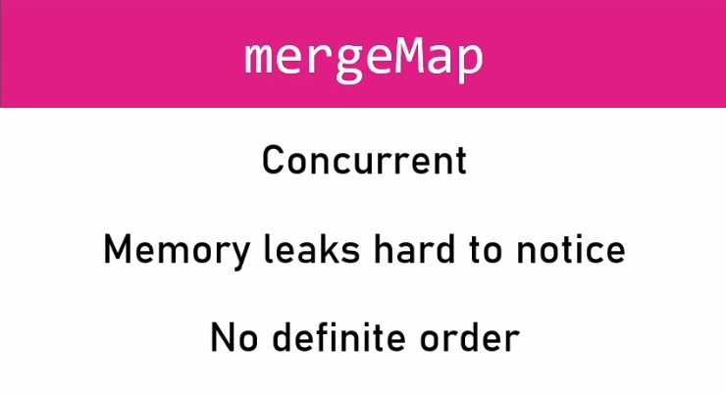
Higher Order Observables
24

Slide 54

Subject
24

Slide 55

BehaviorSubject
24

Slide 56
NGRX
27

Slide 57
NGRX
Component
Component
Angular Redux
State Management
Data
Component
Component
?
?
?
?
Store
Reducer
State
Action
28

Slide 58

NGRX
--save
Means to add this package at dependencies
npm i --save @ngrx/store
npm i --save @ngrx/effects
29

Slide 59




NGRX
Store
Component
Action
State
Reducers
Order
{
Type: “ “,
Payload:.
}
------------------------
30

Slide 60
Store [Data]
State Reducers
change
Receive New Data
Action
Component
Component
Component
Component
31

Slide 61
AppComponent
Component 1
0
Component 2
+
-
32

Slide 62





Store
app.config.ts
Actions
Component (Sender)
Component (Consumer)
33

Slide 63
NGRX [ SELECTORS ]
Use Part of state at Consumer Component
State = {c:0, username:’ ‘ }
Consumer Component
Counter:number = 0;
Constructor(store:Store){
this.store.select(CounterSelector).subscribe({
next:(data)=>{
this.counter = data;
}
})
}
Selector.ts
Let reducer1Sel = CreateFeatureSelector<>(‘reducer1’)
export let CounterSelector = CreateSelector(reducer1Sel)
34

Slide 64
AppComponent
Component 1
Component 2
1- Start To Call API
2- Success
3- Fail
Name | Email | Phone
35

Slide 65

Thank You
mahmoudabdelazizibrahim11@gmail.com

